Slide 1
Web Payment Integration
The PaymentRequest API

Slide 2
Paying for things on the web
Notes:
I'd like to talk about paying for things on the web.

Slide 3
What you will learn about
Paying for things on the Web: UI and UX
The PaymentRequest API
How payment requests work
Resources for getting started
Notes:
In this presentation you'll learn about how to easily integrate payments into your web app UI and UX.

Slide 4


66%
of purchases on mobile are on web
Notes:
It’s no surprise, given the the rise of mobile computing, that a majority of commercial traffic is coming from mobile devices.
What *IS* surprising here [click] is that 66% of that mobile commerce is happening on the web, rather than native apps.

Slide 5
66%
Fewer conversions on mobile websites
Notes:
Unfortunately, we also see a lot lower conversion rates on mobile web relative to desktop web sites.
Mobile conversions is about one third of the desktop conversions.
If you wonder why this is - the answer is pretty simple…

Slide 6
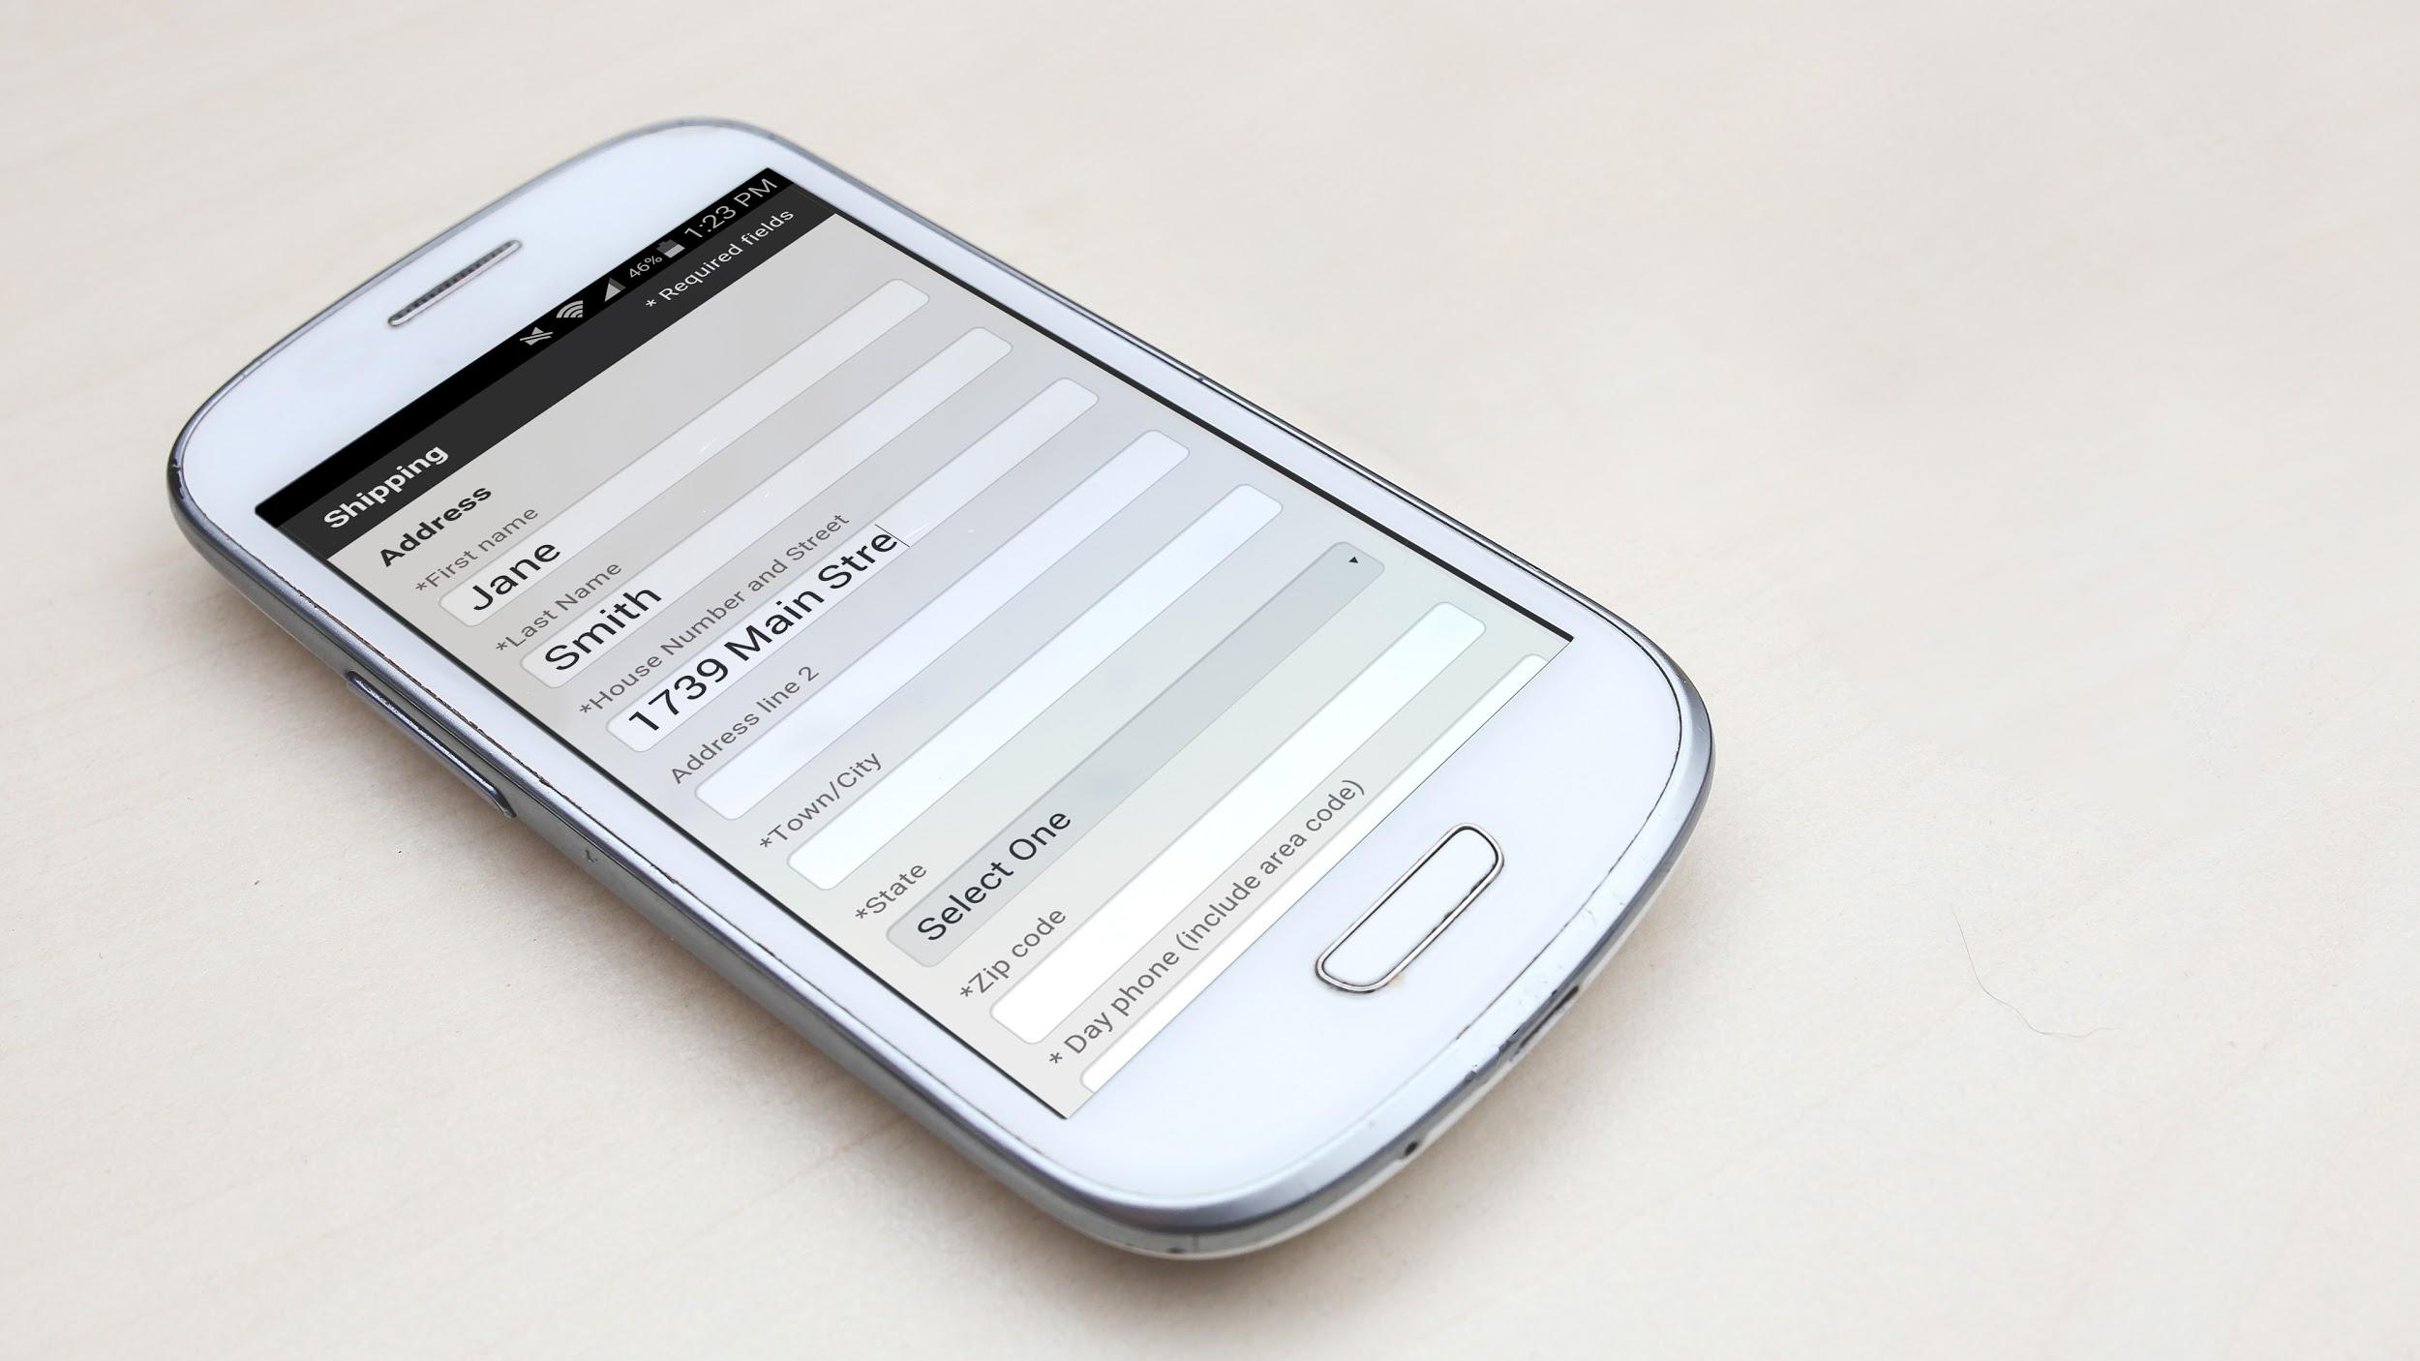
Have you ever
abandoned a purchase
because of the
checkout form?
Notes:
Checking out - collecting payment from the user - is still usually messy.

Slide 7

Checkout forms today
Manual
Tedious
Slow
N-taps
Notes:
Some checkout forms have improved since the beginning of web commerce, but what hasn’t changed is you still have to manually input the same information — credit card, billing address and shipping address.

Slide 8
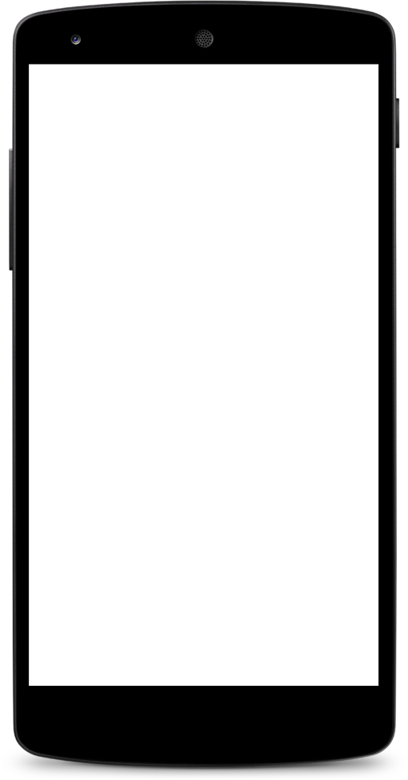
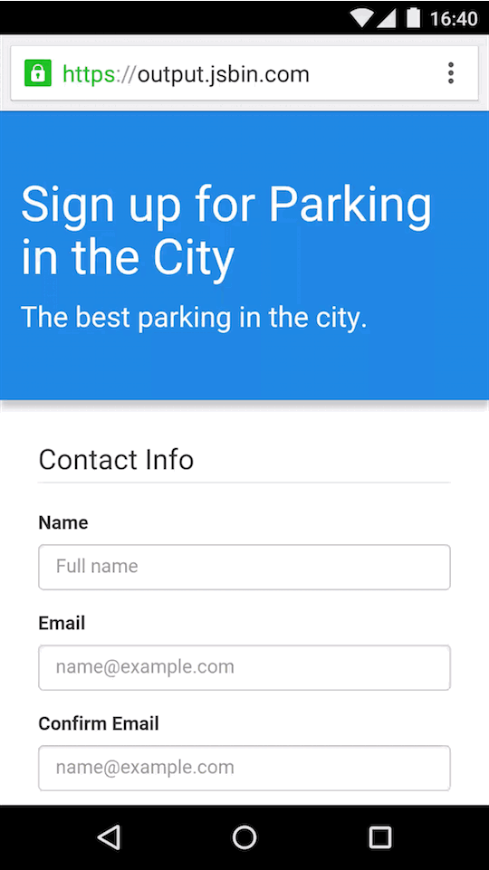
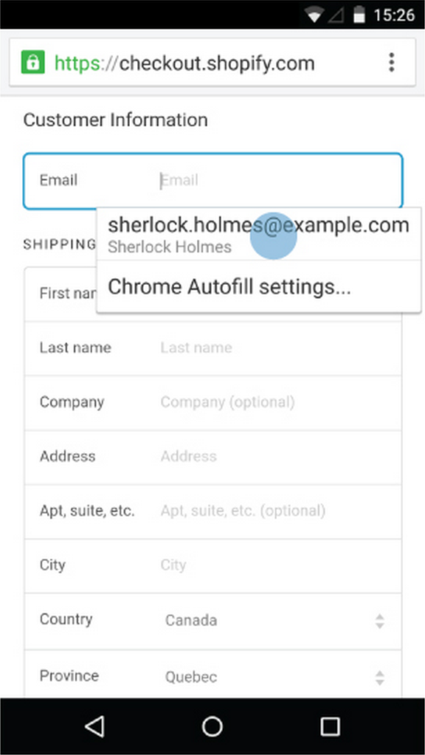
Autofill
Fill web forms
with a single click
Notes:
And just like with sign-in, our first step to solving this problem is autofill.
Because Autofill works on existing forms, you don’t have to modify your site at all
Autofill just works to help users checkout faster.

Slide 9
25
%
Increase in conversion rate from Autofill
Notes:
Autofill is great.
Autofill alone increases conversion rates by 25% on your existing site with no changes to your form
But by using autocomplete attribute just like you've done to sign-in forms you can make this work even better.

Slide 10
<label for="frmNameCC">Name on card</label> <input name="ccname" autocomplete="cc-name"> <label for="frmCCNum">Card Number</label> <input name="cardnumber" autocomplete="cc-number"> <label for="frmCCCVC">CVC</label> <input name="cvc" autocomplete="cc-csc"> <label for="frmCCExp">Expiry</label> <input name="cc-exp" autocomplete="cc-exp">
Notes:
In this example, each fields are annotated as parts of credit card information.
With those autocomplete attributes given, you can precisely autofill parameters.

Slide 11
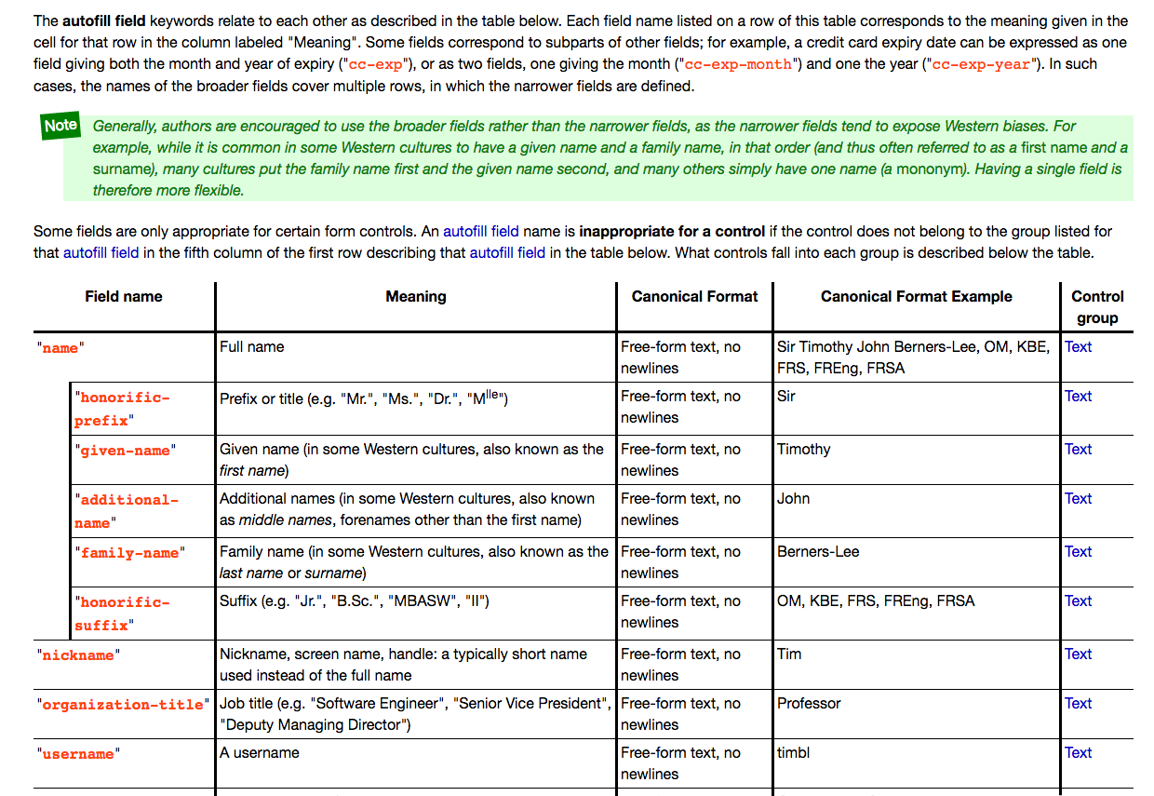

WhatWG autofill
Notes:
If you want to learn more about autocomplete attributes, search the web using "WhatWG autofill" to find the specification for them.
There are many different autocomplete params that helps users filling forms.

Slide 12
Checkout with Autofill
Manual
Automatic
Tedious
Simple
Slow
N-taps
Notes:
Autofill gets rid of the manual nature of data entry, [Click] and makes it much simple for the user. [Click]
However, it’s fundamentally based on the same kind of existing checkout flow — entering a lot of data, usually in multiple pages.
The web checkout process needs to be reinvented.

Slide 13
Imagine a world without forms...
Notes:
The current checkout experience presents you with a form to fill out every time.
For users, though, the ideal experience would be that when it’s time to buy — they just buy.
Sites should be able to focus on creating an amazing and engaging shopping experience without worrying about optimizing a long checkout form.

Slide 14
PaymentRequest API
Notes:
This is where the PaymentRequest API comes in.

Slide 15
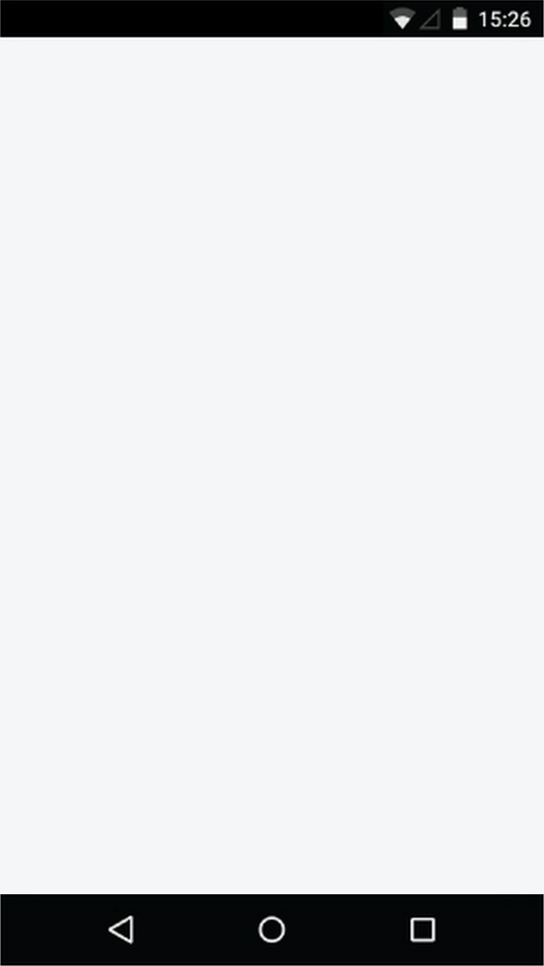
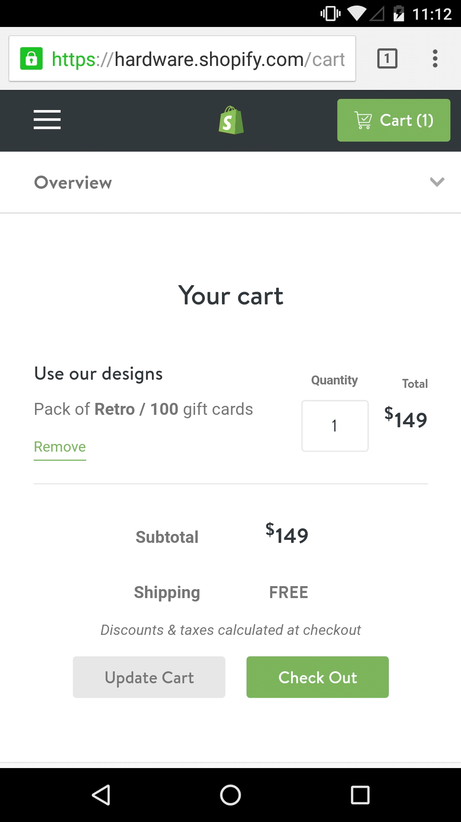
PaymentRequest API
A W3C API to eliminate checkout forms for users and standardize payment collection for sites
Notes:
Imagine a world without forms. This is where Web Payments come in, with the PaymentRequest API. When it’s time to pay, the user just pays.
PaymentRequest is a simple JavaScript API that helps the browser to collect payment information.
This is a simple one-tap checkout for the user, and an easy way for a site to receive a payment.

Slide 16
Checkout with PaymentRequest
Automatic
Simple
Slow
Fast
N-taps
1-tap
Notes:
With the PaymentRequest API
[Click] You can make the whole process much faster by being able to pass the payment information immediately.
[Click] And since the browser is actually taking care of collecting payment information from the user, we go from N-taps to 1-tap.

Slide 17
Site calls PaymentRequest
Browser UI:
collect payment
Browser passes response to site
Payment app
Notes:
Let’s take a quick look at the code flow here.

Slide 18
new PaymentRequest({ supportedMethods: ["visa", "mastercard"]
}, { displayItems: [ { label: "Sub-total", amount: { currencyCode: "USD",
value: "55.00" }, // $55.00 }, { label: "Sales Tax", amount: { currencyCode: "USD",
value: "5.00" }, // $5.00 }
],
total: [{ label: "Total excluding shipping", amount: { currencyCode: "USD",
value: "60.00" }, // $60.00 }] })
Initialize
new PaymentRequest()
- payment methods
- purchase details
- options
Notes:
First, the site initiates a PaymentRequest.
In this request, the website passes to the browser the parameters of the payment - for example, how much is being charged, and, most importantly, which forms of payment the site accepts.

Slide 19
Site calls PaymentRequest
Browser UI:
collect payment
Browser passes response to site
Payment app
Notes:
The browser then determines the intersection of payment methods supported by the site and payment methods that the user has, and presents a selection UI where the user chooses their preferred method of payment.

Slide 20
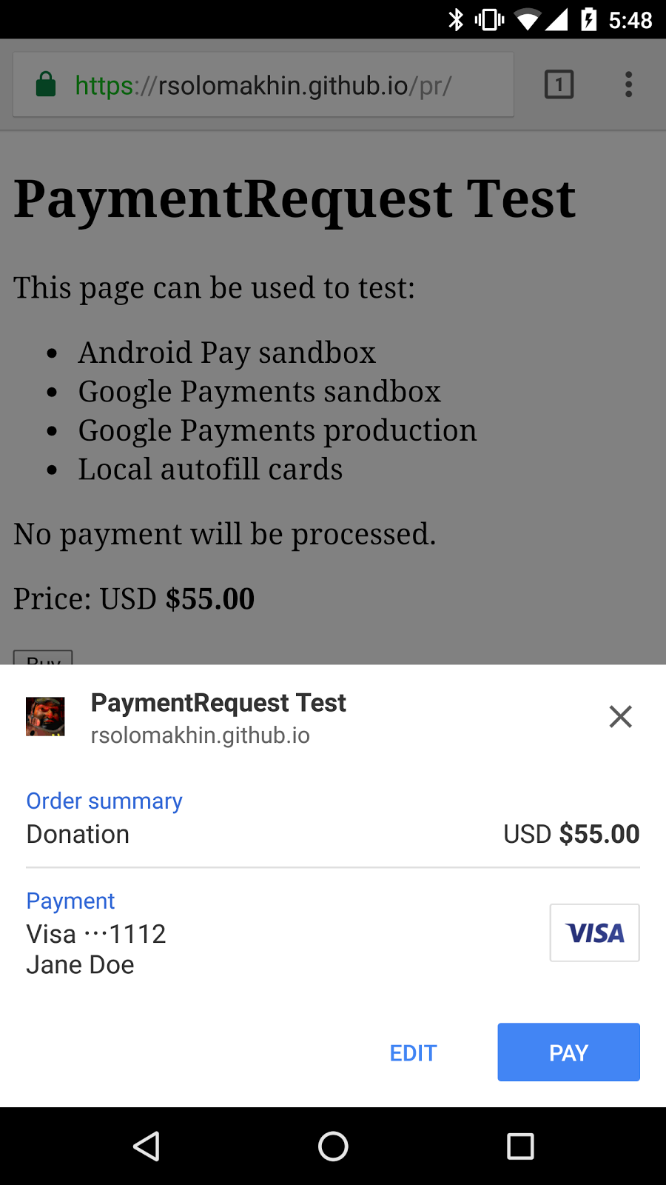
Show UI
.show()
Notes:
The .show() will display this consistent looking native UI.

Slide 21
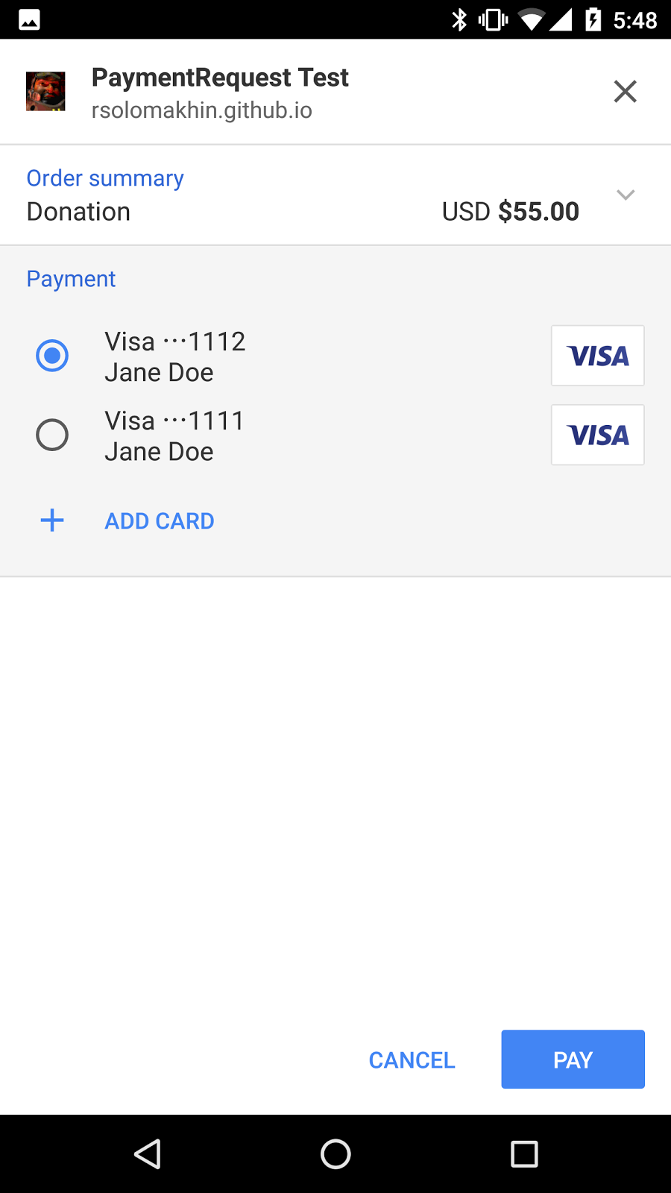
User action
Use selects
- Payment method
- Shipping address
- Shipping option
Notes:
Within this UI, the user can change preference of
- how to pay
- where it should be delivered
- or how it should be delivered
The payment method can be credit cards, or one of apps that are installed on their device such as Android Pay.

Slide 22
User makes payment
"PAY"
Notes:
And finally the user taps on "PAY".

Slide 23
Site calls PaymentRequest
Browser UI:
collect payment
Browser passes response to site
Payment app
Notes:
Then the browser requests a response from the selected payment method

Slide 24
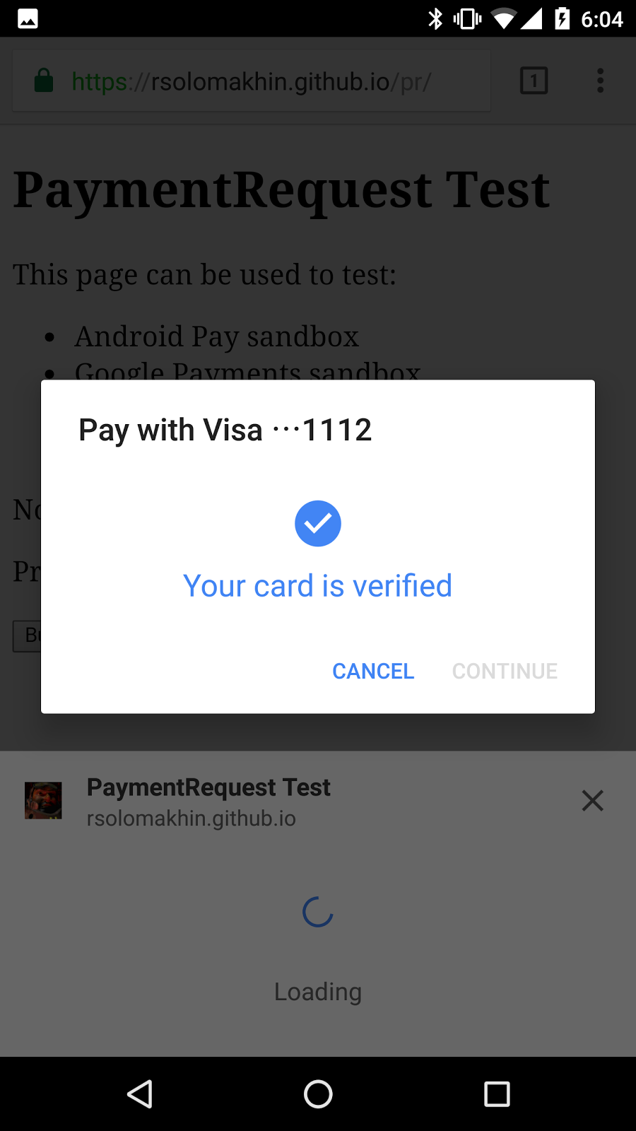
Verification
Payment will be verified
- Server side
- Native app
- Third party website
Notes:
The payment processor verifies the request by examining its details.
And then returns the response directly to the server.

Slide 25
Site calls PaymentRequest
Browser UI:
collect payment
Browser passes response to site
Payment app
Notes:
the website now has all of the information to process the payment.

Slide 26
How about security? Is payment safe?
At least as as safe as existing merchant’s info (credit cards, etc.)
More secure: By extending the API with new one-time-use cards or token payments, you can:
Avoid releasing personal payment information to the merchant
Provide safe payments even on untrusted merchant web sites when you use solutions such as Android Pay
Notes:
The API is more secure with the new payment instruments that are based on modern crypto because you don’t need to enter payment data that can be logged/observed at the point of entry.

Slide 27
How about security? Is autofill safe?
Stored information (for autofill) is stored securely along with other browser information
Not accessible to web sites unless they are autofilled in a form
Server can execute the transaction without saving account/card info
Simple, quick, and streamlined “guest checkout” experience
Notes:
Autofill is safe from website access and typically stored in encrypted storage on the hard drive to prevent disclosure even when the OS is compromised.

Slide 28
Designing PaymentRequest at W3C
Cross-browser
Cross-platform
Open ecosystem
Notes:
This is not just a Chrome-only API. The PaymentRequest API is currently under development in the W3C Web Payments working group. The goal is to create a universal, cross-browser standard for any website to accept any form of payment. With minimal code changes and without proprietary one-off payment APIs.

Slide 29
Checkout with PaymentRequest
Automatic
Simple
Slow
Fast
N-taps
1-tap
Notes:
Eliminates manual and tedious entry by storing the user’s information securely in the browser.
Chrome’s implementation of PaymentRequest uses the same data a user has saved today in Autofill.
Browser passes addresses and credit card details immediately and securely to the site via the PaymentRequest API, rather than through a set of form fields.
Since the browser is collecting payment information from the user, we go from N-taps to 1-tap.

Slide 30
How payment request works

Slide 31
How PaymentRequest() works
Site calls PaymentRequest
Browser UI:
collect payment
Browser passes response to site
Payment app
Notes:
The site initiates a PaymentRequest. In this request, the website passes to the browser the parameters of the payment - for example, how much is being charged, and, most importantly, which forms of payment the site accepts.
----
The browser determines the intersection of payment methods supported by the site and payment methods that the user has, and presents a selection UI where the user chooses their preferred method of payment.
Payment can be anything from a simple credit card in Autofill to a payment application installed on the user’s device.
The browser requests a response from the selected payment method and returns the response directly to the merchant, and the website now has all of the information to process the payment.

Slide 32
PaymentRequest samples
PaymentRequest samples
PaymentRequest lets you accept payment from different payment methods, and allows other options for shipping and delivery/contact information. See the code samples at googlechrome.github.io:
Credit cards
Android Pay
Free shipping
Shipping options
Dynamic shipping
Contact info
Server side
Notes:
A number of code samples are available for all payment methods, current and future.

Slide 33
PaymentRequest: supported methods
var methodData = [
{ supportedMethods: ['visa', 'discover'] }
];
Notes:
First, you need to gather data about a transaction.
Step 1: Tell PaymentRequest all the ways you (the site) can get paid (currently limited to credit cards + Android Pay).
Reference for deeper understanding of code

Slide 34
PaymentRequest: transaction details
var details = { total: {label: 'Total', amount: {currency: 'USD', value: '55.00'}}, displayItems: [{ label: 'Subtotal', amount: {currency: 'USD', value: '65.00'} }], ...
// shipping options
Notes:
Step 2: You also need details about the actual transaction: cost, currency, shipping options, and so on.
Continued on next slide

Slide 35
PaymentRequest: transaction details
// …
shippingOptions: [{
id: ‘free’,
label: ‘Worldwide free shipping!’,
amount: {currency: ‘USD’, value: ‘0.00’},
selected: true //optional
}]
};
Notes:
Step 2 continued: You also need details about the actual transaction: cost, currency, shipping options, and so on.

Slide 36
PaymentRequest: options
var options = { requestShipping: true, requestPayerEmail: true, requestPayerPhone: true }
Notes:
Step 3: You can also specify options for shipping, and whether to request payer email or phone number.

Slide 37
PaymentRequest: make it!
var request = new PaymentRequest( methodData, // required payment method data details, // required information about transaction options // optional parameter for things like shipping, etc. );
Notes:
Combine steps 1 to3: create a PaymentRequest object by calling the PaymentRequest constructor. This step is typically (but not always) associated with a user-initiated action indicating their intent to make a purchase. The object is constructed using parameters that contain required data.

Slide 38
Show the selection UI
request.show().then(function(paymentResponse) { // Process paymentResponse here... paymentResponse.complete('success'); }).catch(function(err) { console.error('Something bad happened', err.message); });
Notes:
Activate the PaymentRequest interface by calling its show() method. This method invokes a native UI that allows the user to examine the details of the purchase, add or change information, and finally, pay. Upon a user approval for a payment request, the show() method's promise resolves, resulting in a PaymentResponse object.
After payment information is received, the app should submit the payment information to your payment processor for processing. The UI will show a spinner while the request takes place. When a response has come back, the app should call complete() to close the UI.
The complete() method tells the user agent that the user interaction is over and allows the app to notify the user of the result and to address the disposition of any remaining UI elements.

Slide 39
PaymentResponse: properties
methodName: A string indicating what the chosen payment method is (e.g., visa)
details: A dictionary containing information for methodName
shippingAddress: The shipping address of the user, if requested
shippingOption: The ID of the selected shipping option, if requested
payerEmail: The email address of the payer, if requested
payerPhone: The phone number of the payer, if requested
Notes:
The payment response object contains everything needed to submit a payment.
For credit card payments, the response is standardized. For non-credit card payments (e.g., Android Pay), the response will be documented by the provider. A credit card response contains the following in a dictionary:
cardholderName
cardNumber
expiryMonth
expiryYear
cardSecurityCode
billingAddress

Slide 40
PaymentRequest: shipping detail events
request.addEventListener('shippingaddresschange', function(evt) { evt.updateWith(new Promise(function(resolve) { var newDetails = getNewDetails(request.shippingaddress); resolve(newDetails); })); });
Notes:
There are useful events you need to be aware of: shippingaddresschange, shippingoptionchange.
These should be handled when the user makes a change from the payment UI.
You can add an event listener for the shippingaddresschange event, which fires on user selection of a shipping address.
You can then validate the ability to ship to that address, calculate shipping options, and update your details.shippingOptions with the new shipping options and pricing information.

Slide 41
Resources
Code samples
Full fancy demo
Android pay samples
Integration Guide on Web Fundamentals

Slide 42
Extra credit

Slide 43
Support for Android Pay
var request = new PaymentRequest( [{ // add Android Pay as supported
supportedMethods: [“https://android.com/pay”],
data: { // add Android Pay parameters (next slide) }], { total: {...}, displayItems: [...] });
Notes:
The code is from https://googlechrome.github.io/samples/paymentrequest/android-pay/ (rouslan@google.com)
Continued on next slide
This slide is originally from Chris Wilson
To enable support for Android Pay, you need to specify that app’s payment method identifier in the list of supported payment methods. Then there are some application specific parameters required by Android Pay that you will need to pass in through PaymentRequest - the same parameters required today when an Android Application requests payment directly via the native Android Pay API. While we’re showcasing Android Pay here, its important to remember that the changes to your PaymentRequest constructor to support some other kind of payment application should be very similar to what you see here. All you would need to add is a method identifier and any application specific parameters required by the new application - such as an API key or other merchant identifier.

Slide 44
Support for Android Pay (cont.)
"merchantName": "Put Your Android Pay Merchant Name Here", "merchantId": "put_your_android_pay_merchant_id_here", "allowedCardNetworks": ["AMEX", "VISA", "MASTERCARD"], "paymentMethodTokenizationParameters": {
"tokenizationType": "GATEWAY_TOKEN",
"parameters": { "gateway": "stripe", "stripe:publishableKey": "...", "stripe:version": "2016-07-06"}}}
Notes:
The code is from https://googlechrome.github.io/samples/paymentrequest/android-pay/ (rouslan@google.com)
This slide is originally from Chris Wilson
To enable support for Android Pay, you need to specify that app’s payment method identifier in the list of supported payment methods. Then there are some application specific parameters required by Android Pay that you will need to pass in through PaymentRequest - the same parameters required today when an Android Application requests payment directly via the native Android Pay API. While we’re showcasing Android Pay here, its important to remember that the changes to your PaymentRequest constructor to support some other kind of payment application should be very similar to what you see here. All you would need to add is a method identifier and any application specific parameters required by the new application - such as an API key or other merchant identifier.

